Slide 1
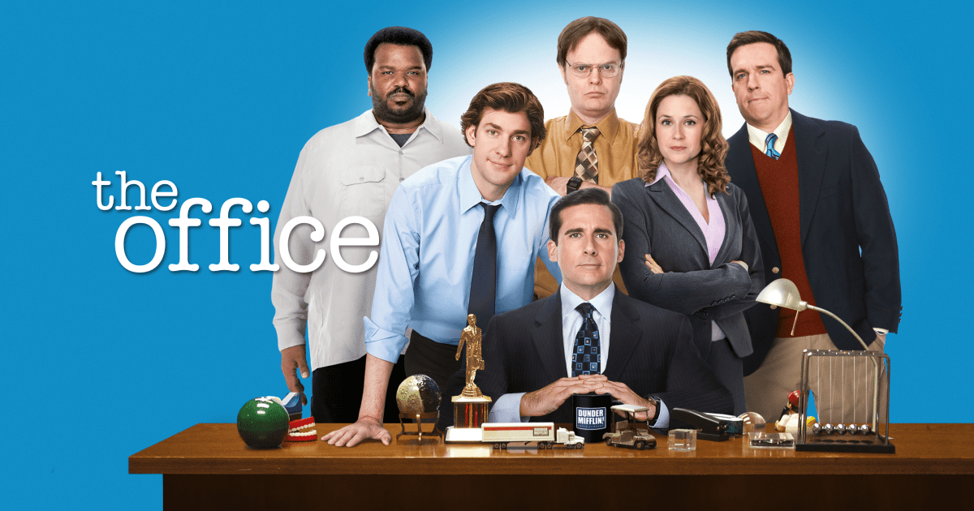

Slide 2

Question No. 1
How much does Michael’s beloved Plasma screen TV cost?
A) $300
B) $250
C) $150
D) $200

Slide 3
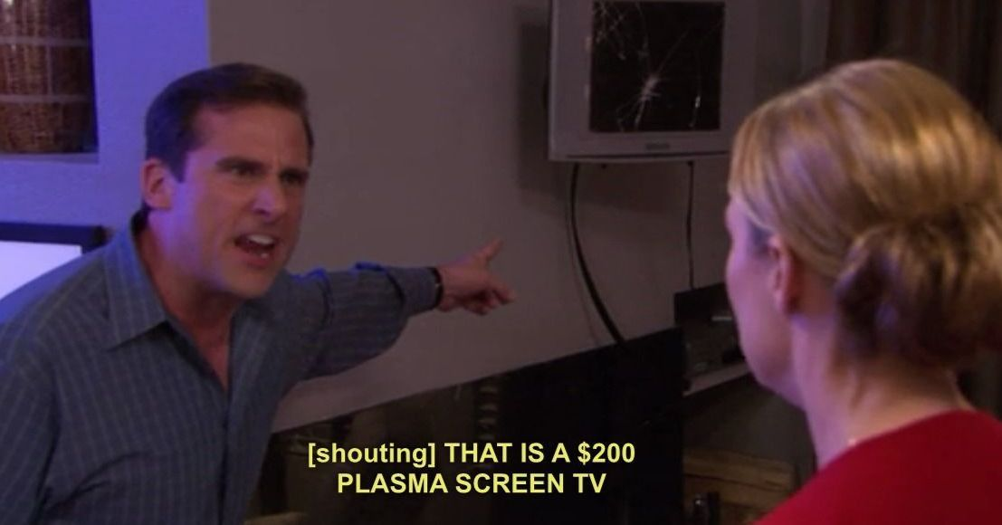
Question No. 1
How much does Michael’s beloved Plasma screen TV cost?
D) $200

Slide 4
Question No. 2
What’s the name of Dwight’s porcupine?
A) Harold
B) Henry
C) Henrietta
D) Howard

Slide 5

Question No. 2
What’s the name of Dwight’s porcupine?
C) Henrietta

Slide 6
Question No. 3
What’s Pam’s favorite flavor of yoghurt?
A) Mixed berry
B) Cranberry
C) Mixed fruits
D) Strawberry

Slide 7
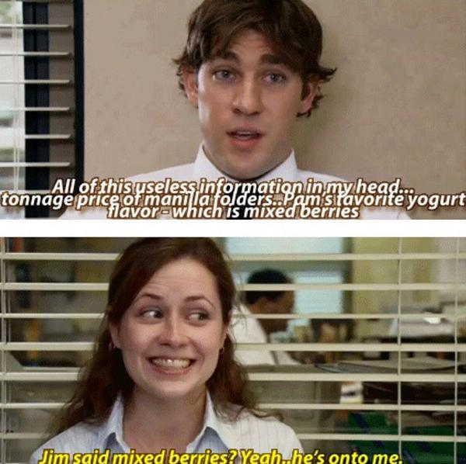
Question No. 3
What’s Pam’s favorite flavor of yoghurt?
A) Mixed Berry

Slide 8
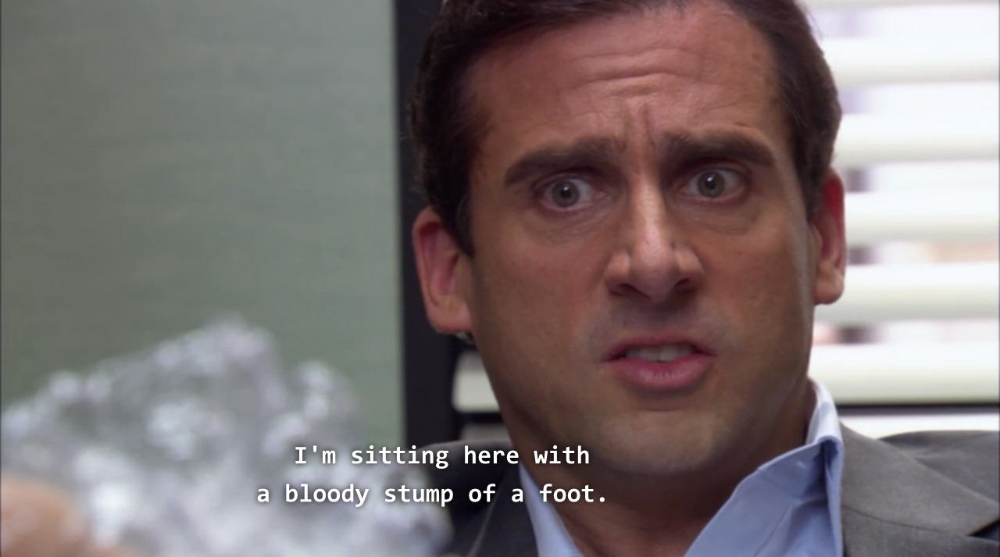
Question No. 4 (No option)
What does Michael ask Pam to rub on his foot that he burned on a George Foreman grill?

Slide 9
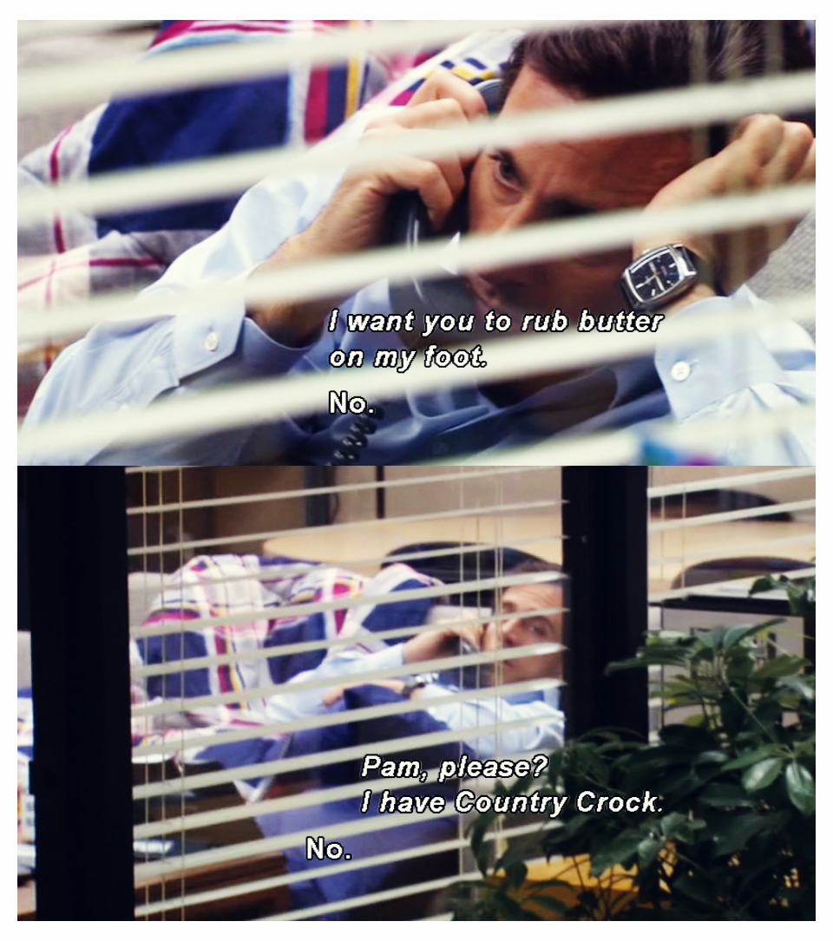
Question No. 4 (No option)
What does Michael ask Pam to rub on his foot that he burned on a George Foreman grill?
Butter

Slide 10
Question No. 5
What’s Kevin’s reaction when Kelly reveals her middle name?
C) I thought Rajani ghandha was a boy’s name
B) Did you happen to have worked in a call center?
A) Jokes on you
D) So you’re not a red indian?

Slide 11
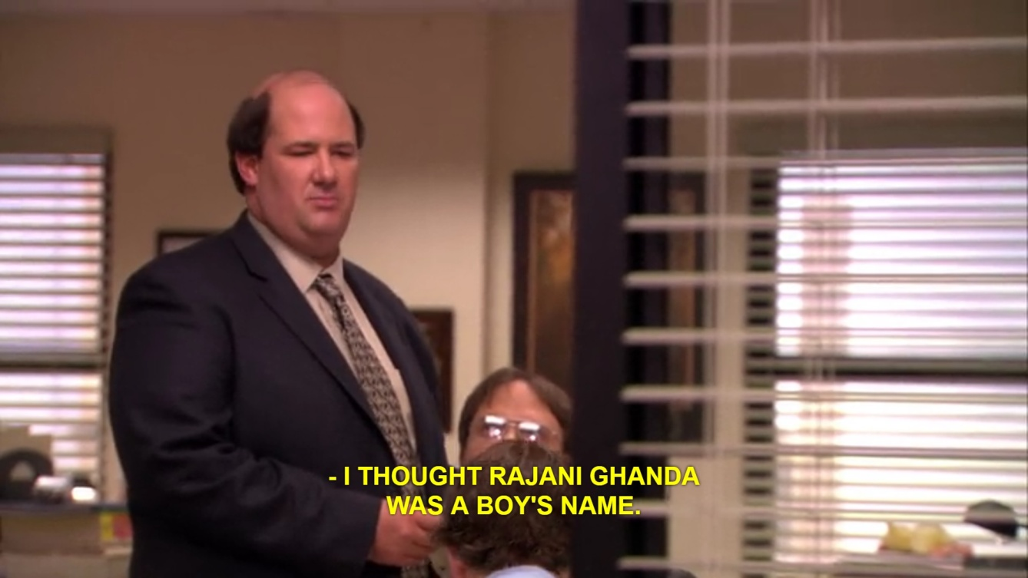
Question No. 5
What’s Kevin’s reaction when Kelly reveals her middle name?
C) I thought Rajani ghandha was a boy’s name

Slide 12
Question No. 6
What kind of sandwich does Michael dream about when he is the head of Michael Scott Paper Company?
A) Peppemint & Tuna
B) M&M & Nutella
C) Peanutbutter & Tuna
D) Nutella & Tuna

Slide 13
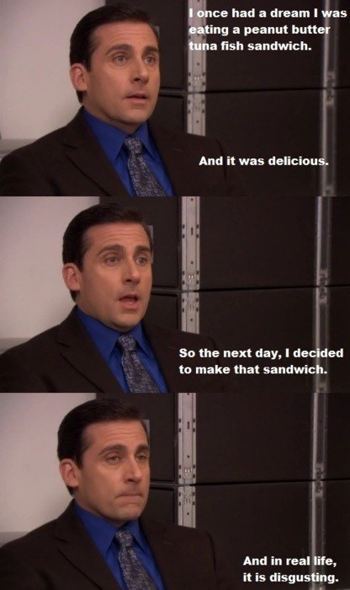
Question No. 6
What kind of sandwich does Michael dream about when he is the head of Michael Scott Paper Company?
C) Peanutbutter and Tuna

Slide 14
Question No. 7
Dwight keeps an extra pair of shoes for the special occasion. What shoes?
A) Oxford
B) Crocks
C) Birkenstocks
D) Moccassins

Slide 15
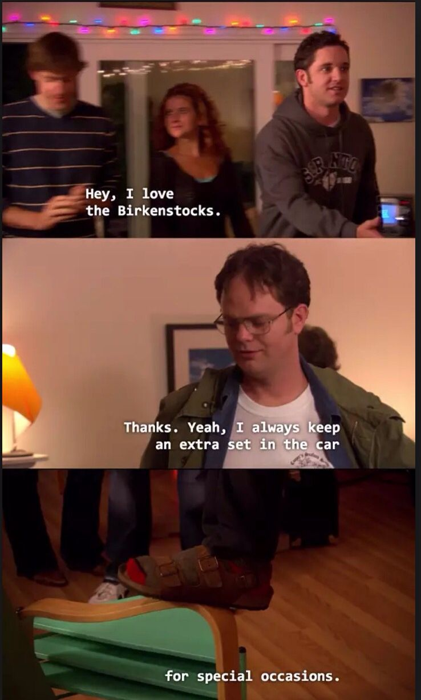
Question No. 7
Dwight keeps an extra pair of shoes for the special occasion. What shoes?
C) Birkenstocks

Slide 16
Question No. 8
Whom does Dwight blame for suggesting him to put a banana in his holster?
A) Michael
B) Pam
C) Kevin
D) Jim

Slide 17
Question No. 8
Whom does Dwight blame for suggesting him to put a banana in his holster?
B) Pam

Slide 18
Question No. 9
On diversity day, who put the “Eskimo” card on his/her head?
A) Jim
B) Phyllis
C) Devon
D) Oscar

Slide 19
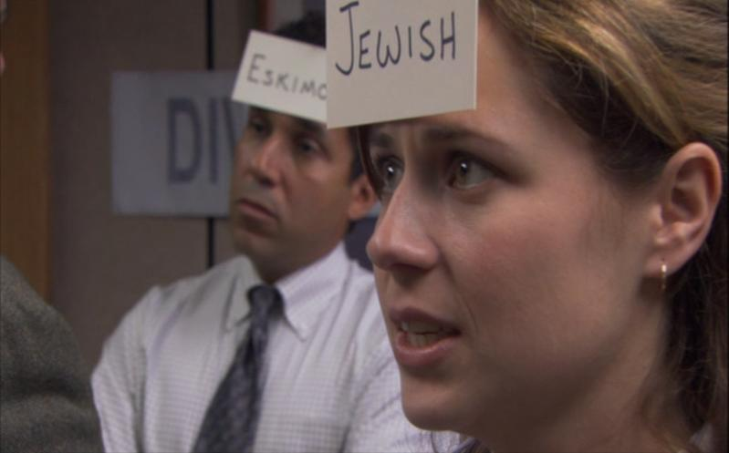
Question No. 9
On diversity day, who put the “Eskimo” card on his/her head?
D) Oscar

Slide 20
Question No. 10
What's in the thermos that Michael offers Pam during morning deliveries for the Michael Scott Paper Company?
A) Milk & Sugar
B) Milk and Coffee
C) Coffee and Cream
D) Cream and Sugar

Slide 21
Question No. 10
What's in the thermos that Michael offers Pam during morning deliveries for the Michael Scott Paper Company?
A) Milk
& Sugar

Slide 22
Question No. 11
What brand is Michael wearing on the day he accidentally wearing a woman's suit?
A) Silkmaison
B) Missterious
C) Gucci
D) Chanel

Slide 23
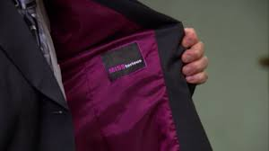
Question No. 11
What brand is Michael wearing on the day he accidentally wearing a woman's suit?
B) MISSterious

Slide 24
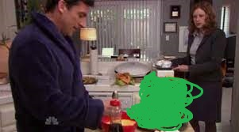
Question No. 12
A) Pancakes
B) Waffles
C) French Toast
D) Cake

Slide 25
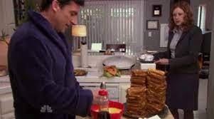
Question No. 12
C) French Toast

Slide 26
Question No. 13
What radio sticker can be seen in the office?
A) Froggy 111
B) Froggy 101
C) Froggy 110
D) Froggy 100

Slide 27
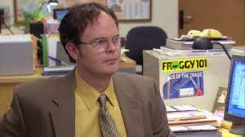
Question No. 13
What radio sticker can be seen in the office?
B) Froggy 101

Slide 28
That’s all folks!
It was easy

